Slide 1
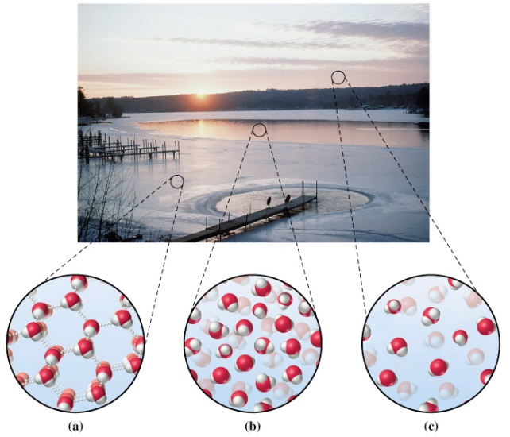
General Chemistry
Principles and Modern Applications
Petrucci • Harwood • Herring
8th Edition
Chapter 1: Matter—Its Properties and Measurement
Philip Dutton
University of Windsor, Canada
Prentice-Hall © 2002
Slide <number> of 19
General Chemistry: Chapter 1
Prentice-Hall © 2002

Slide 2
Contents
Physical properties and states of matter
Système International Units
Uncertainty and significant figures
Dimensional analysis
http://cwx.prenhall.com/petrucci/chapter1/deluxe.html
Slide <number> of 19
General Chemistry: Chapter 1
Prentice-Hall © 2002
Notes:
Chemistry 140 Fall 2002

Slide 3
Properties of Matter
Matter: Occupies space, properties of mass and inertia
Composition: Parts or components
ex. H₂O, 11.9% H and 88.81% O
Properties: Distinguishing features
physical and chemical properties
Slide <number> of 19
General Chemistry: Chapter 1
Prentice-Hall © 2002

Slide 4
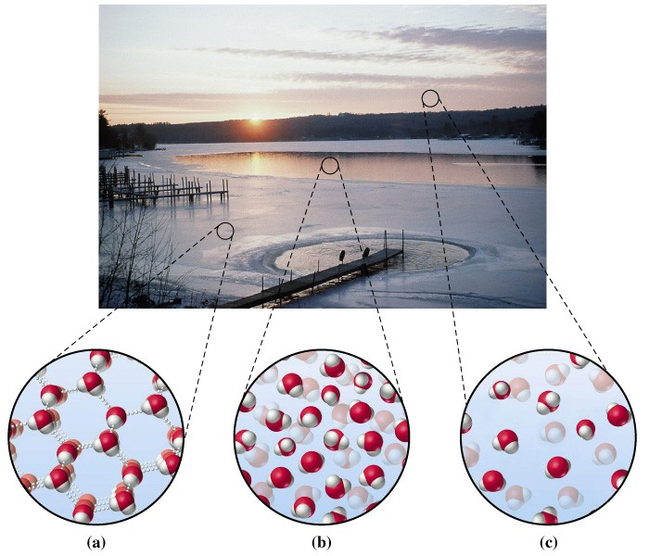
States of Matter
Slide <number> of 19
General Chemistry: Chapter 1
Prentice-Hall © 2002
Notes:
Chemistry 140 Fall 2002

Slide 5
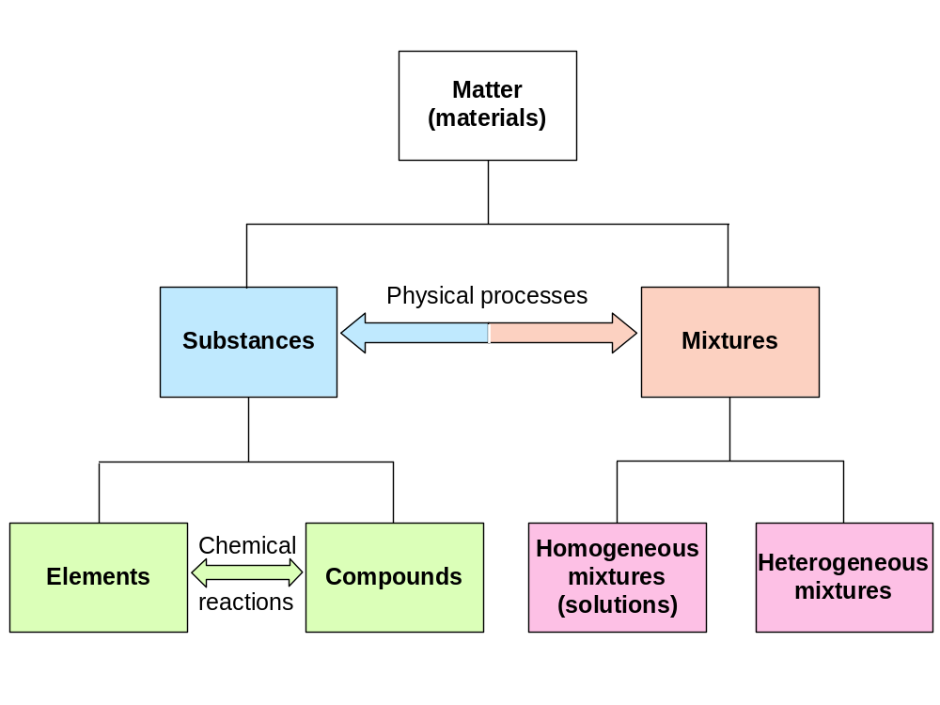
Classification of Matter
-made up of very tiny units
-building block of a different chemical element.
-elements and compouns
-can vary in composition and properties.
-the components separate
into distinc regions.
Slide <number> of 19
General Chemistry: Chapter 1
Prentice-Hall © 2002

Slide 6
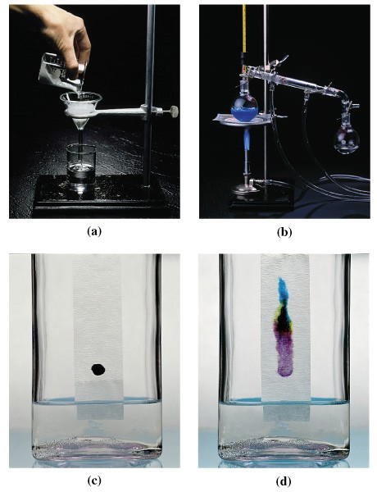
Separations
-separated into its components by physical means.
Slide <number> of 19
General Chemistry: Chapter 1
Prentice-Hall © 2002

Slide 7
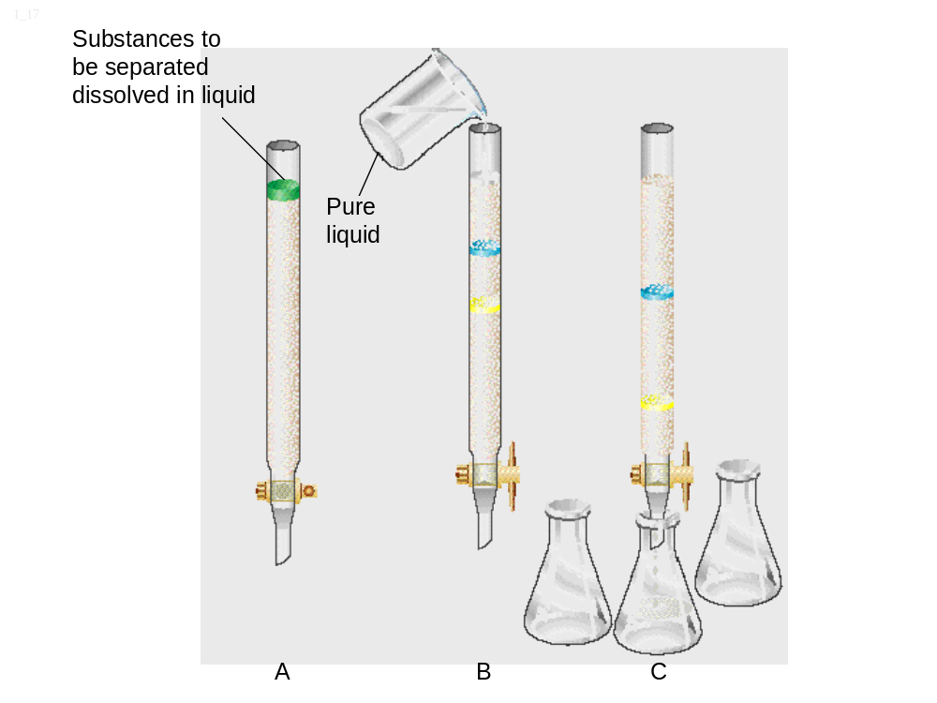
Separating Mixtures
Chromatography
mixture
Slide <number> of 19
General Chemistry: Chapter 1
Prentice-Hall © 2002

Slide 8
Significant Figures
Count from left from first non-zero digit.
Adding and subtracting.
Use the number of decimal places in the number with the
fewest decimal places.
Number
6.29 g
0.00348 g
9.0
1.0 × 10⁻⁸
100 eggs
100 g
π = 3.14159
Significant
Figures
3
3
1.14
0.6
11.676
13.416 ➔
2
2
infinite
13.4
bad notation
various
Slide <number> of 19
General Chemistry: Chapter 1
Prentice-Hall © 2002

Slide 9
Significant figures
Multiplying and dividing.
Use the fewest significant figures.
Rounding Off
3rd digit is increased if
4th digit ≥ 5
Report to 3 significant figures.
10.235 ➔
12.4590 ➔
19.75 ➔
15.651 ➔
.
10.2
12.5
19.8
15.7
0.01208 ÷ 0.236
= 0.512
= 5.12 × 10⁻³
Slide <number> of 19
General Chemistry: Chapter 1
Prentice-Hall © 2002

Slide 10
Units
S.I. Units
Length metre, m
Mass Kilogram, kg
Time second, s
Temperature Kelvin, K
Quantity Mole, 6.022×10²³ mol⁻¹
Derived Quantities
Force Newton, kg m s⁻²
Pressure Pascal, kg m⁻¹ s⁻²
Energy Joule, kg m² s⁻²
Other Common Units
Length Angstrom, Å, 10⁻⁸ cm
Volume Litre, L, 10⁻³ m³
Energy Calorie, cal, 4.184 J
Pressure
1 Atm = 1.064 x 10² kPa
1 Atm = 760 mm Hg
-The scientific system of measurement is called the international system of unit (SI).
-Modern version of metric system
Slide <number> of 19
General Chemistry: Chapter 1
Prentice-Hall © 2002

Slide 11
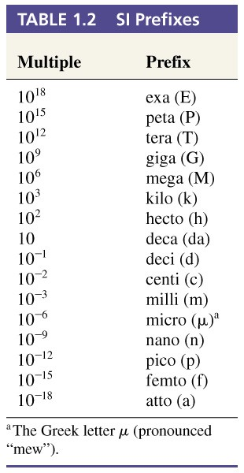
Slide <number> of 19
General Chemistry: Chapter 1
Prentice-Hall © 2002

Slide 12
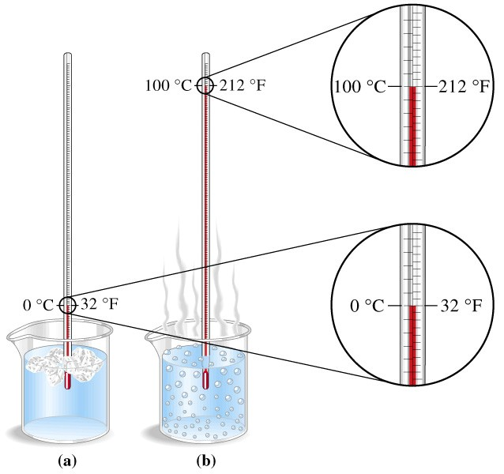
Temperature
-most commonly measured in °C
-converted to the K
Slide <number> of 19
General Chemistry: Chapter 1
Prentice-Hall © 2002

Slide 13
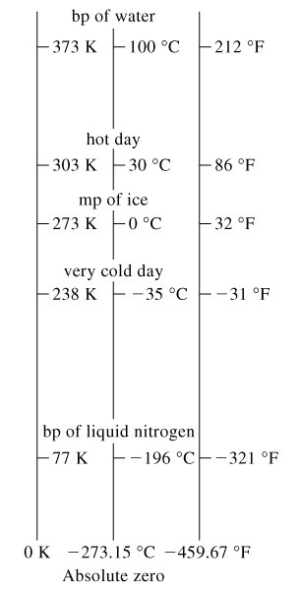
Relative Temperatures
Slide <number> of 19
General Chemistry: Chapter 1
Prentice-Hall © 2002

Slide 14
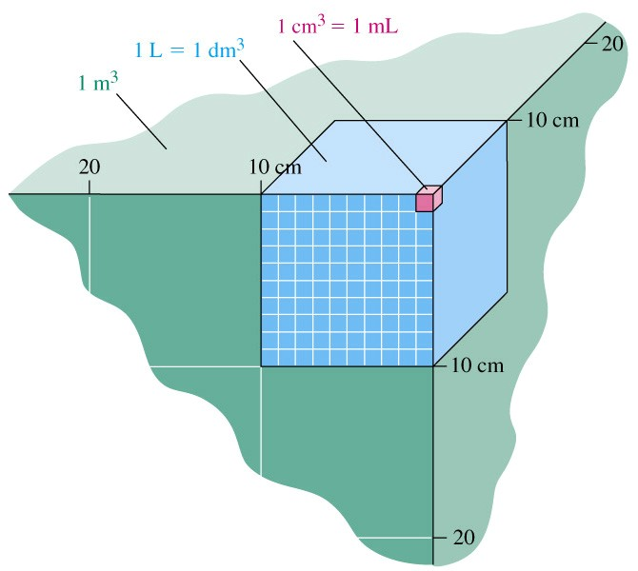
Volume
Slide <number> of 19
General Chemistry: Chapter 1
Prentice-Hall © 2002

Slide 15
Density
= m/V
m=Vδ V=m/δ
g/mL
Mass and volume are extensive properties
-dependent on the quentity of matter observed.
Density is an intensive property.
Slide <number> of 19
General Chemistry: Chapter 1
Prentice-Hall © 2002

Slide 16
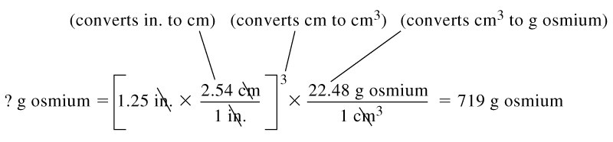
Conversion
What is the mass of a cube of osmium that is 1.25 inches on each side?
Have volume, need density
= 22.48g/cm³
Slide <number> of 19
General Chemistry: Chapter 1
Prentice-Hall © 2002

Slide 17
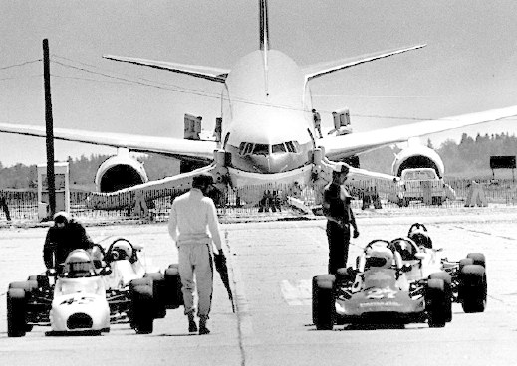
Wrong units
The Gimli Glider, Q86, p30
Slide <number> of 19
General Chemistry: Chapter 1
Prentice-Hall © 2002

Slide 18
Uncertainties
Systematic errors.
  Thermometer constantly 2°C too low.
Random errors
  Limitation in reading a scale.
Precision
  Reproducibility of a measurement.
Accuracy
  How close to the real value.
Slide <number> of 19
General Chemistry: Chapter 1
Prentice-Hall © 2002

Slide 19
End of Chapter Questions
1, 3, 5, 12, 14, 17,
18, 20, 30, 41, 49,
50, 61, 72, 74, 79
Slide <number> of 19
General Chemistry: Chapter 1
Prentice-Hall © 2002

Slide 20
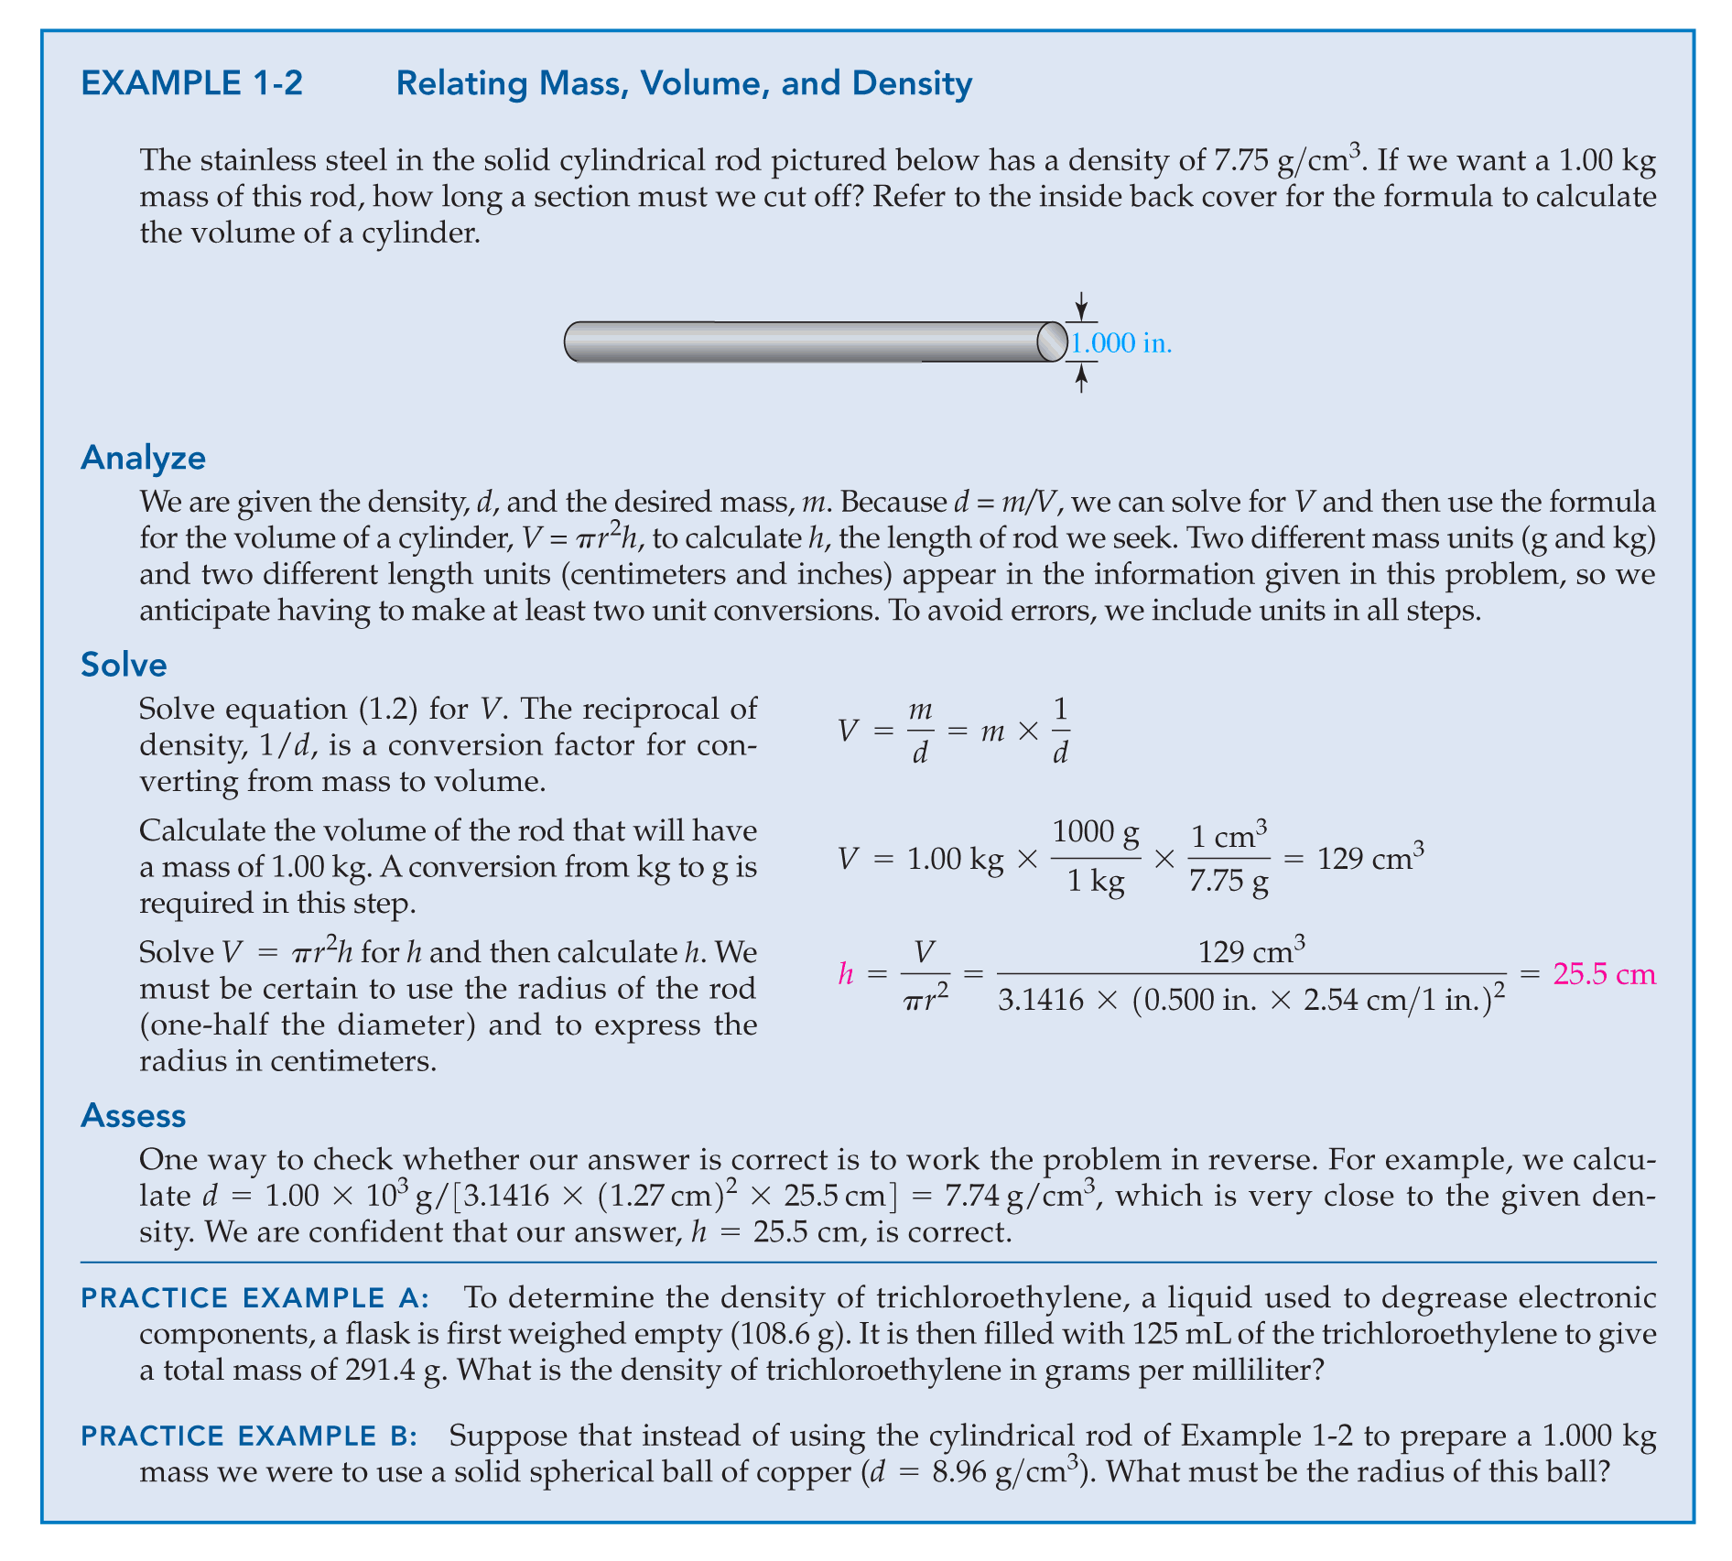
1 - <number>
Copyright © 2011 Pearson Canada Inc.

Slide 21
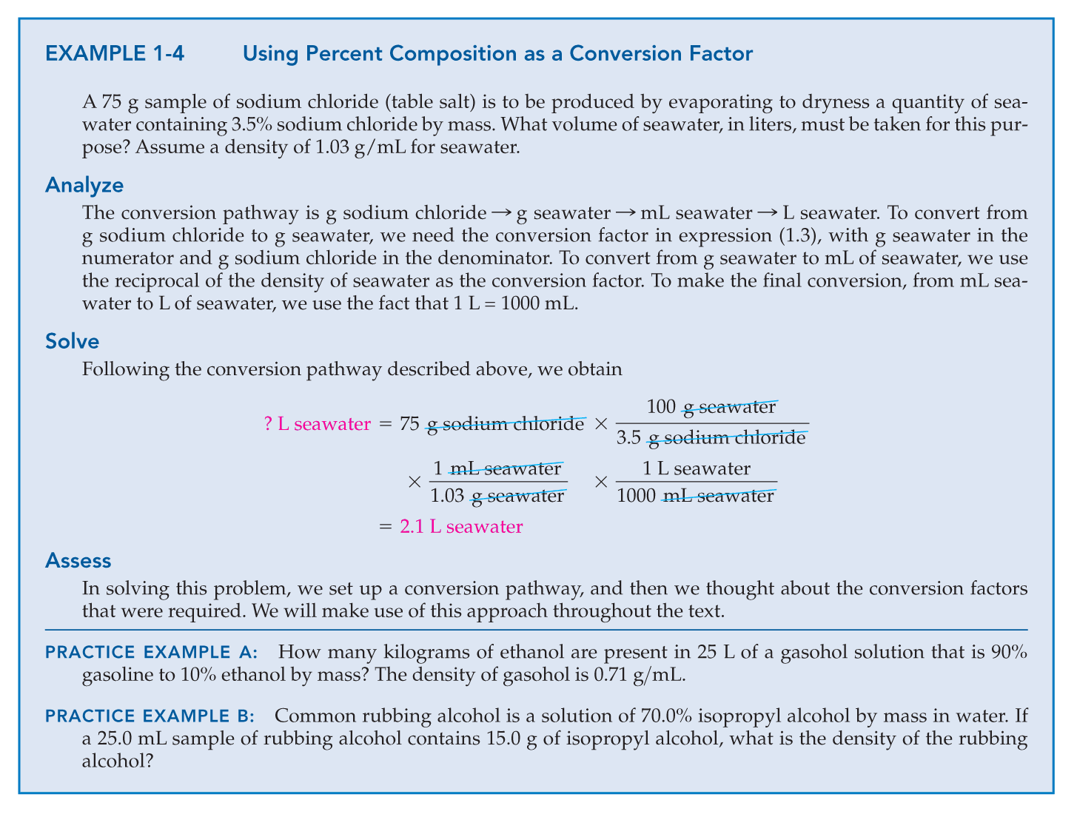
Copyright © 2011 Pearson Canada Inc.
1 - <number>

